Slide 1

Step 2 Washing mc Lot Entry app spec
Agenda
Steps to scan QR code & get auto lot entry
Addition of Tag S/N record in App
Pokayoke to avoid multiples entries of same tag
NG lot lock mechanism in App (NG lot no. must not go gemba)
Lot QR code format

Slide 2
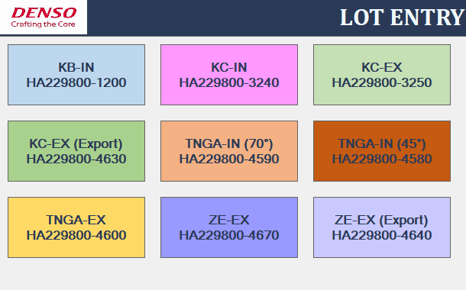
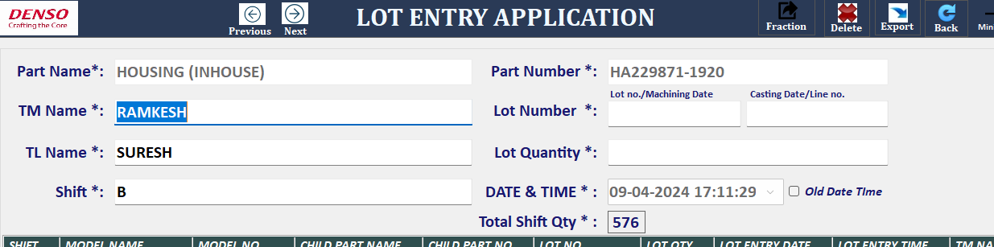
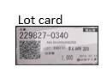
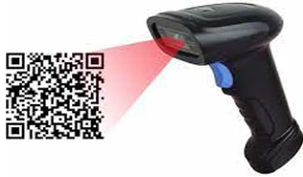
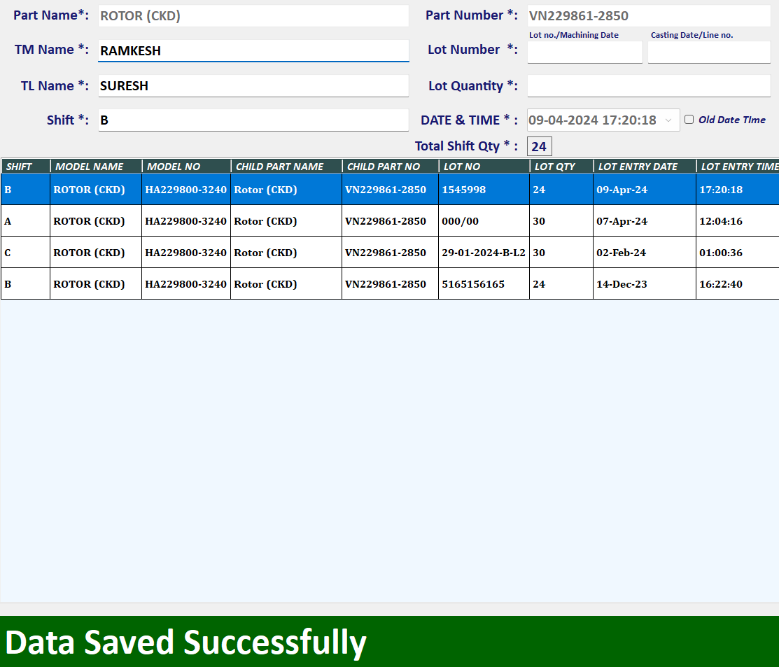
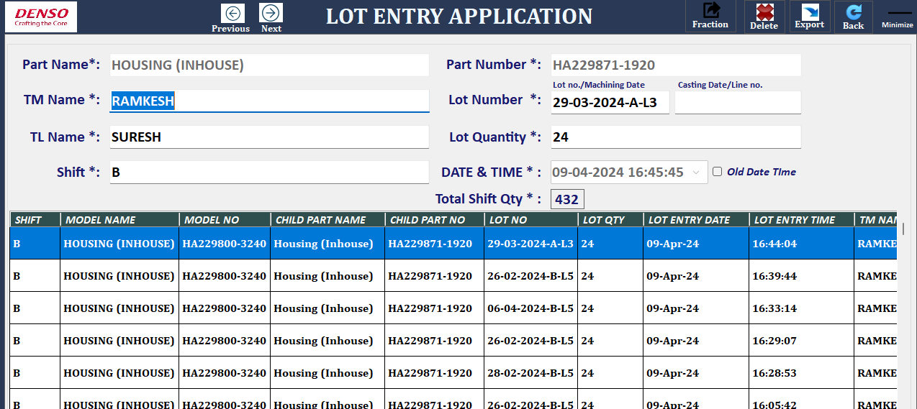
1. Steps to scan QR code & get auto lot entry
TM to select respective model
1
1
2
At shift start , select Child part & enter TM,TL name info
2
Pick Child part lot card & scan*.
Data will be saved in App auto mode
3
Pick other Child part lot card & scan.
(No need to do any operation manually in app) From Housing lot screen Data will be auto entered in App by scanning other child part Rotor Lot card
3
Rotor
4
4
Housing
Continue lot entries for all child parts lot tag
*In Case , wrong Lot card picked against first time selected window →NG Lot Card error must come with Error notification

Slide 3
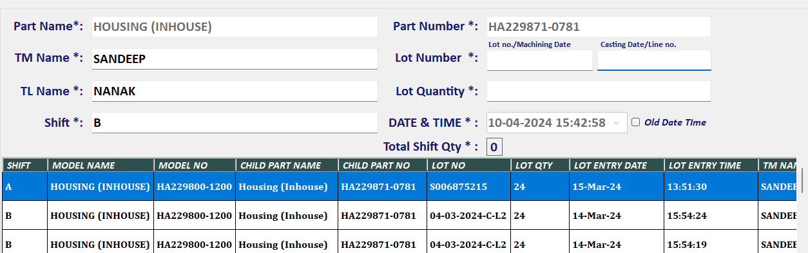
2. Addition of Tag S/N record in App
Addition of Tag S/N in each entry .
S/n
S/n
3. Pokayoke to avoid multiples entries of same tag
➔If same Tag is scanned again and again , App should not accept it once if it is already scanned and data successfully entered. From Tag S/N each label will make difference with each other.

Slide 4
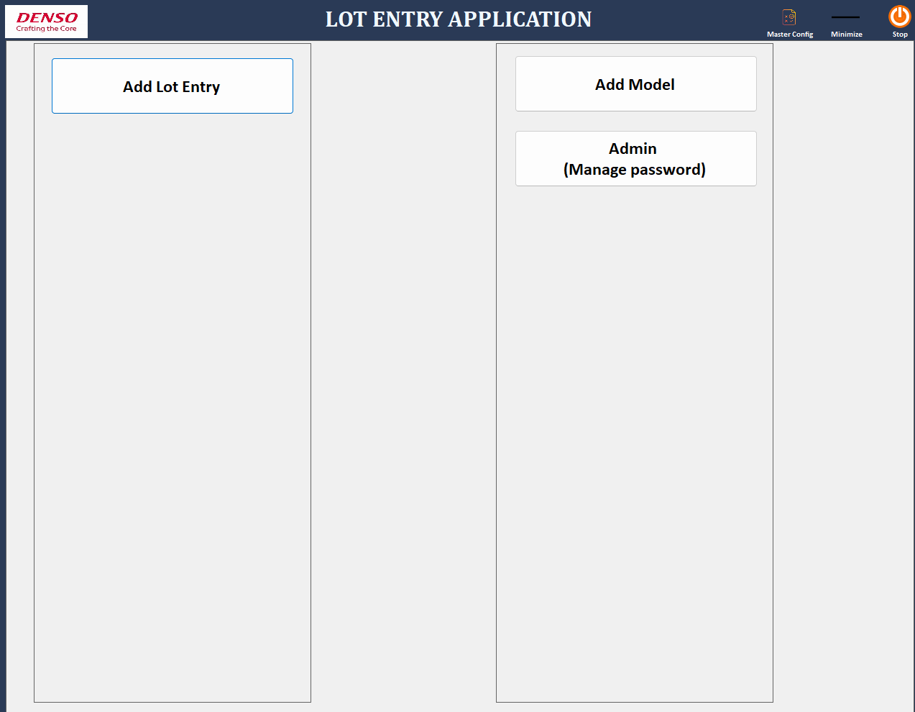
4.NG lot lock mechanism in App (NG lot no. must not be used in assy)
➔In App , make window to entre NG lot info
➔ App will keep NG lot info into memory & during NG lot card come at gemba ,App will not accept NG lot card & show “NG Lot cannot use , Call TL” Purpose of this feature demand is Electronics recall issue due to NG lot assembled in FG.
NG Lot Locking
Select Child Part Name
Select Child Part No.
Enter NG Lot numbers

Slide 5
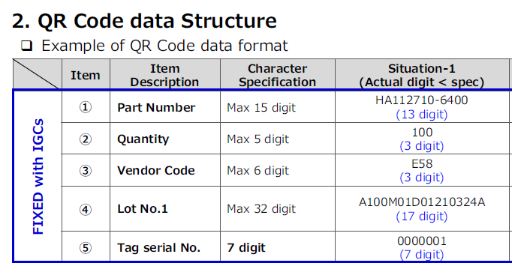


5.QR code structure
In Washing mc lot app ,n=4 items need to capture from QR code (yellow portion)
1
2
3
4
5
1
4
3
2
5

